Slide 1
Retrieving Viewing and Navigating BIBFRAME Records in Alma
Yoel Kortick
Yoel.Kortick@clarivate.com

Slide 2
Agenda
  Introduction to this presentation
  Searching for and retrieving the Work
  Searching for and retrieving the Instance
  Viewing and editing the Work and Instance after retrieving
  The Tree, RDF/XML, and Table View modes

Slide 3
Introduction to this presentation

Slide 4
Introduction to this presentation
BIBFRAME records in Alma, both the Works as well as the Instances, can be retrieved via the Alma repository search.
After retrieving a Work or an Instance, the staff use can navigate within the record as well as to and from the associated Work or Instance.
In a separate presentation we will show how it is also possible to edit a Work or an Instance from the Alma repository search results
Disclaimer:
  BIBFRAME in Alma is currently undergoing a major development phase. Consequently, screenshots and statements in this presentation are subject to change.
  In order for the BIBFRAME functionality to be used, BIBFRAME must be enabled in your institution. See Enabling BIBFRAME in Your Institution

Slide 5
Searching for and retrieving the Work

Slide 6
Searching for and retrieving the Work
The Work Search allows the staff user to directly search for and retrieve Works using the indexes of the Work.
  Additionally, it is possible to arrive to the Work via a link from the Instance.
The Work search displays results similar to other repository searches.
  There are, however, minor variations in the results details, sections, actions, facets and customizations. These variations are due to the unique nature of the Work record

Slide 7
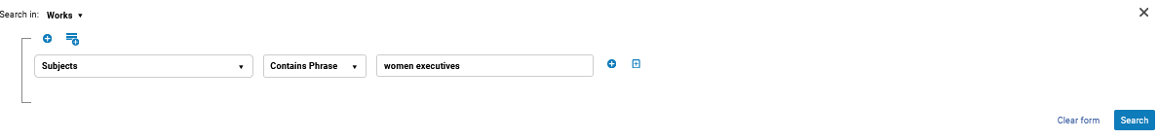
Searching for and retrieving the Work
To perform a Works Search:
Select “Works” in the search type drop menu and enter the search content in the text field.
Simple Search
Advanced Search

Slide 8
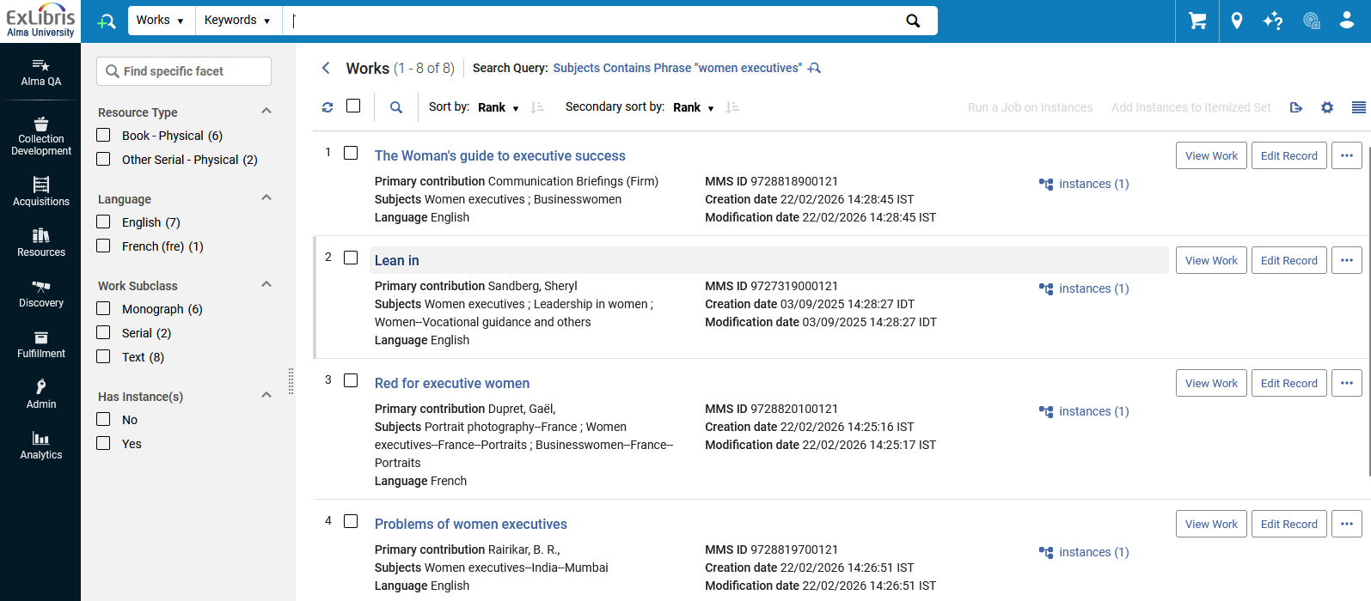
Searching for and retrieving the Work
The Works search results are displayed.
Here we have the results of a “Works” advanced search for “Subjects Contains Phrase "women executives" ”

Slide 9
Searching for and retrieving the Work
From the results of the Works repository search the staff user may:
  View the Work (in encoded in RDF/XML as well as in an on the fly MARC conversion)
  Edit the Work
  View the related Linked Data
  View the related Instance(s) (and then edit them)
  Delete the Work
  Facet by Resource Type
  Facet by Language
  Facet by Work Sub Class
  Facet by Has Instance(s)

Slide 10
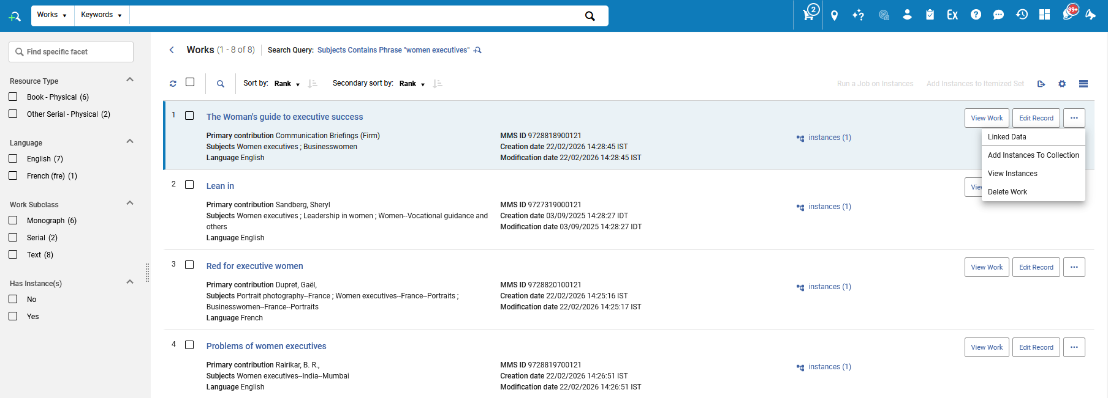
Searching for and retrieving the Work
Several actions can be performed on the Works from the repository search results.

Slide 11
Searching for and retrieving the Work
The Works search displays results similar to other repository searches
For example, Title, MMS ID, Creation date, Modification date, Subjects, etc. appear in the results.
Additionally, there are unique fields and buttons which are displayed to reflect the Works search, such as “Instances” and “View Work”.
Users can also refine their search by selecting to search based on an attribute from linked instances.
  The search index drop menu indicates indexes that are an attribute from a linked "instance" with parentheses, for example “Edition (Instance)”.
  More on this soon with a real example.

Slide 12
Searching for and retrieving the Work
For example, Title, MMS ID, Creation date, Modification date, Subjects, etc..
Fields and buttons are displayed to reflect the Works search, such as Instances and View Work

Slide 13
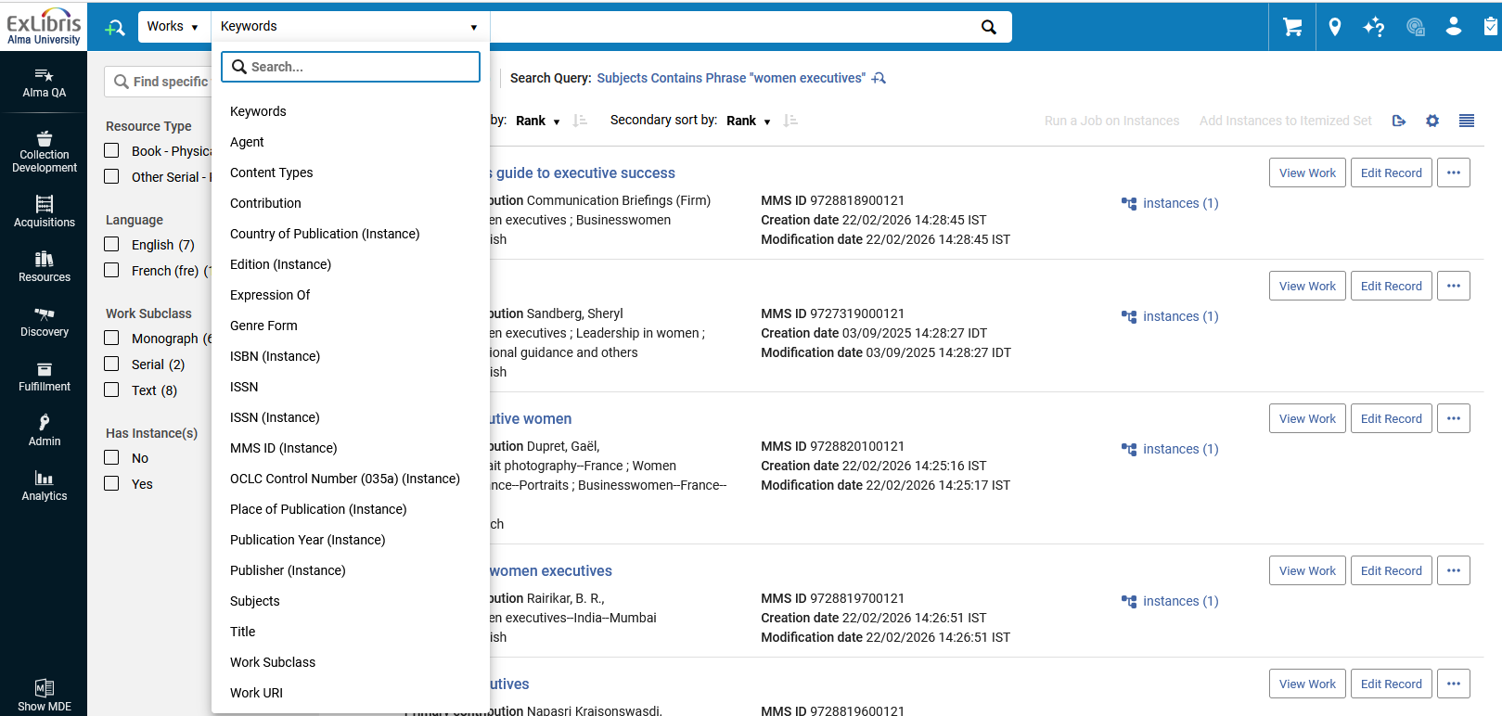
Searching for and retrieving the Work
Users can also refine their Works search by selecting to search based on an attribute from linked instances.
The search index drop down menu indicates indexes that are an attribute from a linked "instance" with parentheses.

Slide 14
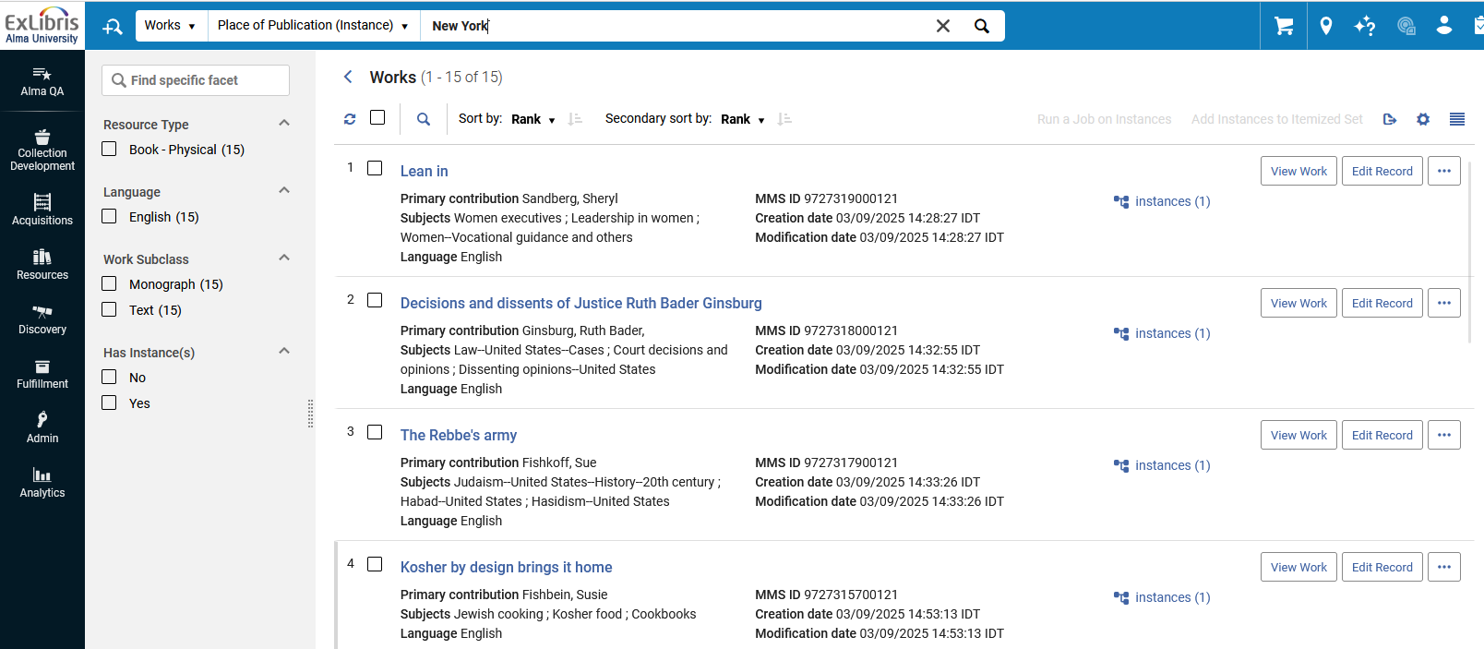
Searching for and retrieving the Work
Here for example, we have searched for all Works that have an instance which has a place of publication “New York”. We are using index “Place of Publication (Instance)”
Let’s take a look, for example, at the Instance of the Work “Decisions and dissents of Justice Ruth Bader Ginsburg”

Slide 15
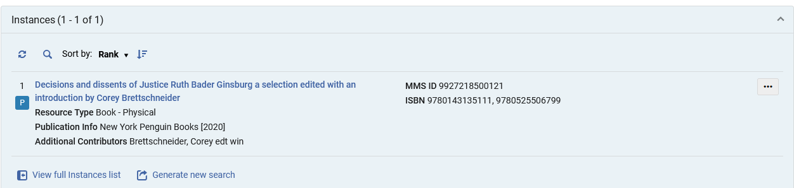
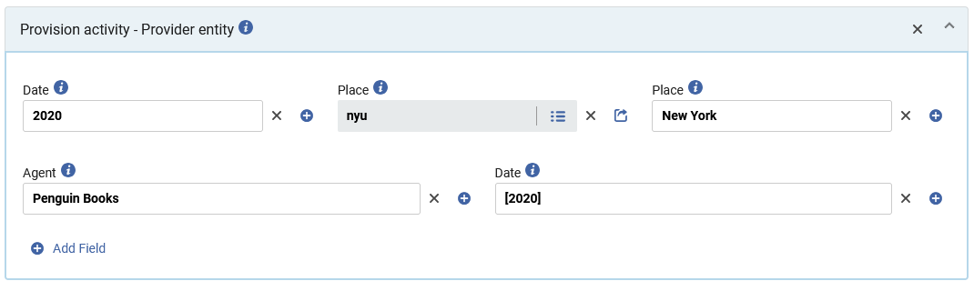
Searching for and retrieving the Work
We see that at least one of the Instances of the work “Decisions and dissents of Justice Ruth Bader Ginsburg” has a place of publication “New York”

Slide 16
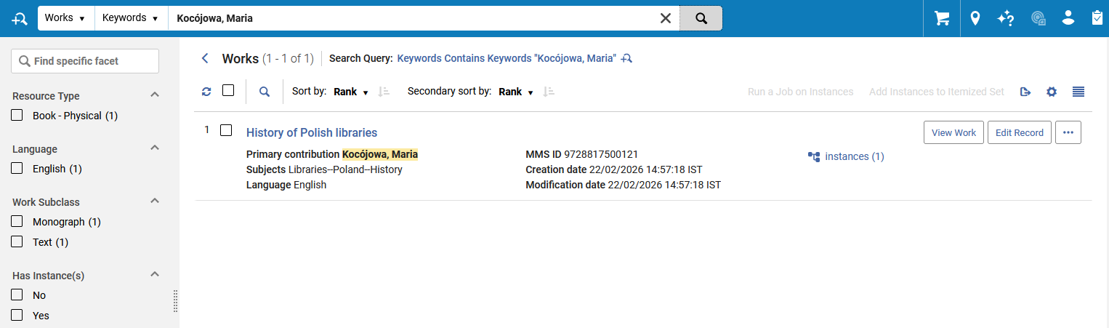
Searching for and retrieving the Work
From the results screen of the Work search, users can
  View instances from the Works by selecting the “Instances” quick link (Instances Indicator).
  View further details regarding the Work by selecting a record.
We will now click “Instances” to view the instances of the Work “History of Polish Libraries”

Slide 17
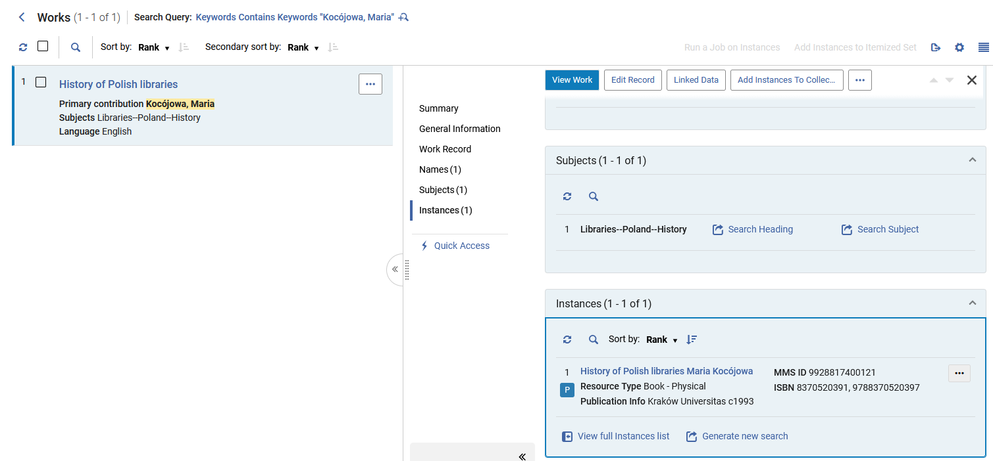
Searching for and retrieving the Work
We have clicked the “Instances” link and now we can see the Instances of the Work “History of Polish Libraries”

Slide 18
Searching for and retrieving the Work
From the results screen of the Work search, users can
  View instances from the Works by selecting the Instances quick link (Instances Indicator).
  View further details regarding the Work by selecting a record.
We will now click the Work “History of Polish Libraries”

Slide 19
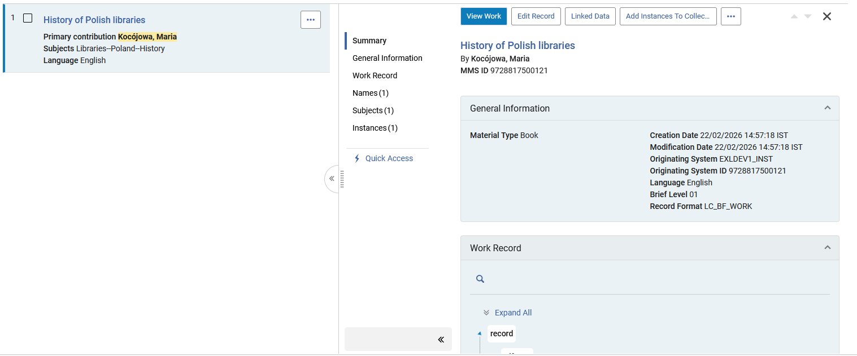
Searching for and retrieving the Work
Now we can see the details of the Work “History of Polish Libraries”
Previously, when we clicked the “Instances” link from the “Works” repository search results, we arrived at the same place. However, we were already focused on the “Instances” section.

Slide 20
Searching for and retrieving the Work
The BIBFRAME work and instance record view within the persistent searches (All Titles and Works) are displayed by default in a tree view
This provides a view that is more focused on the content of the record and a less technical RDF/XML view.

Slide 21
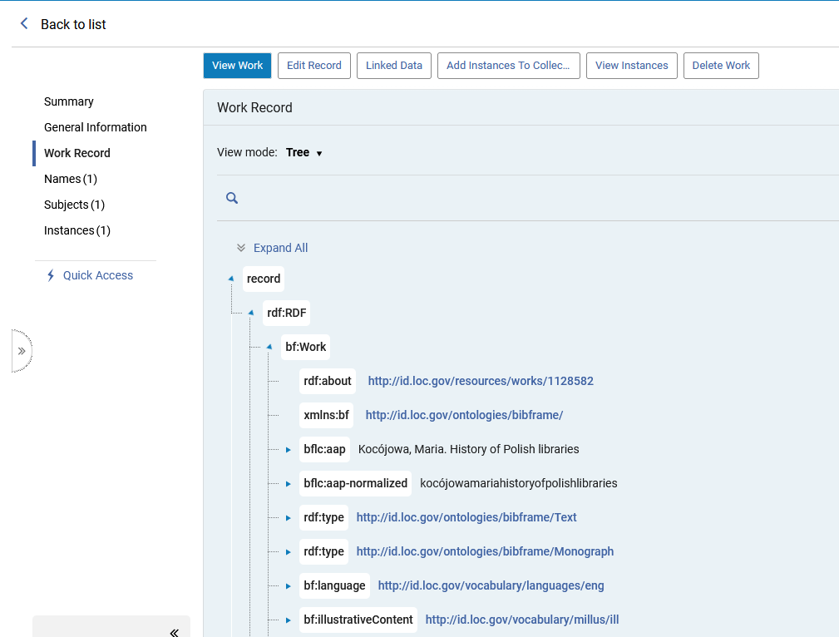
Searching for and retrieving the Work
The tree view of the Work record
This “Tree” format can also be viewed in a “RDF/XML” view as well as a “Table” view.
This is described in detail in section “The Tree, RDF/XML, and Table View modes” in this presentation.

Slide 22
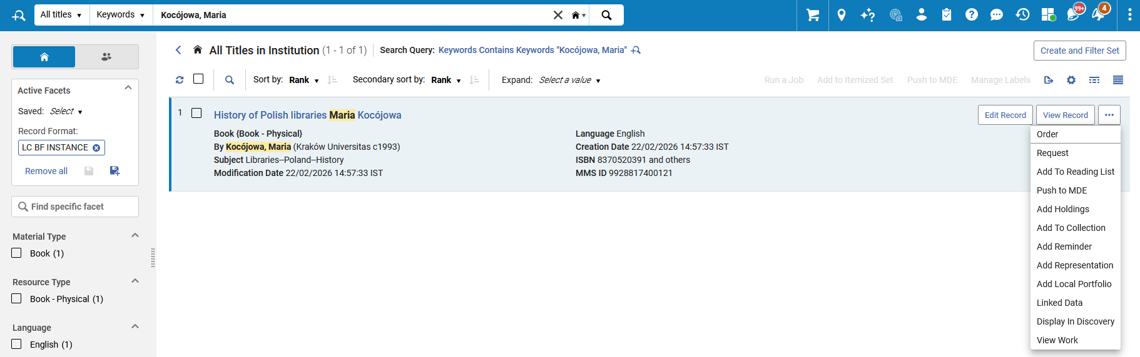
Searching for and retrieving the Work
Note that it is also possible to view the Work record from the Instance
From the Instance we will now click “View Work”

Slide 23
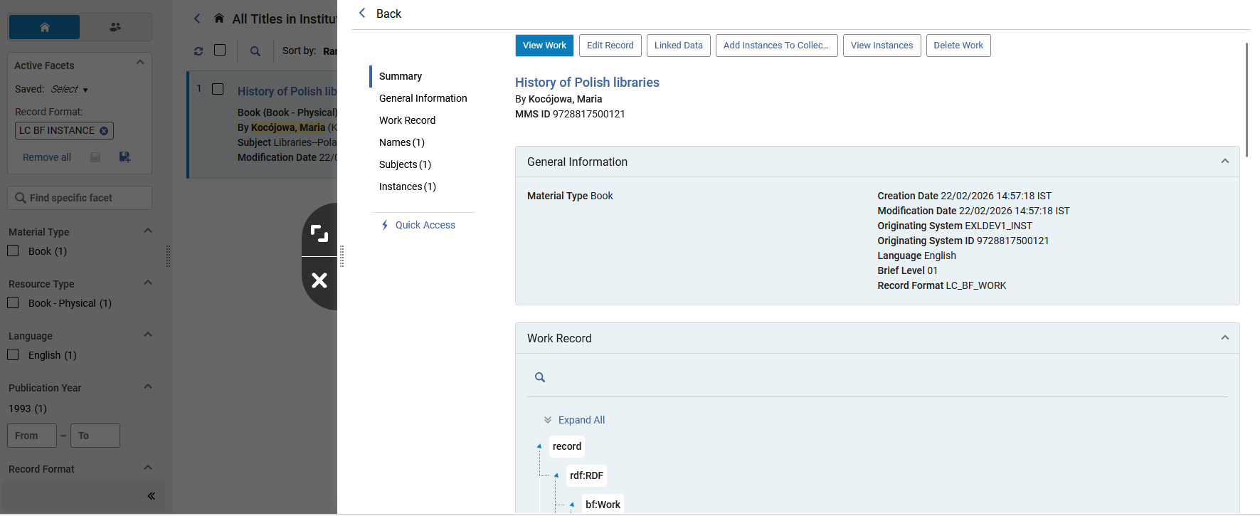
Searching for and retrieving the Work
After clicking “View Work” from the Instance, the Work opens in a sliding panel.

Slide 24
Searching for and retrieving the Instance

Slide 25
Searching for and retrieving the Instance
BIBFRAME Instances can be retrieved via an “All Titles” search.
See:
  BIBFRAME Bibliographic All Titles Search
  BIBFRAME Keyword Search Indexes

Slide 26
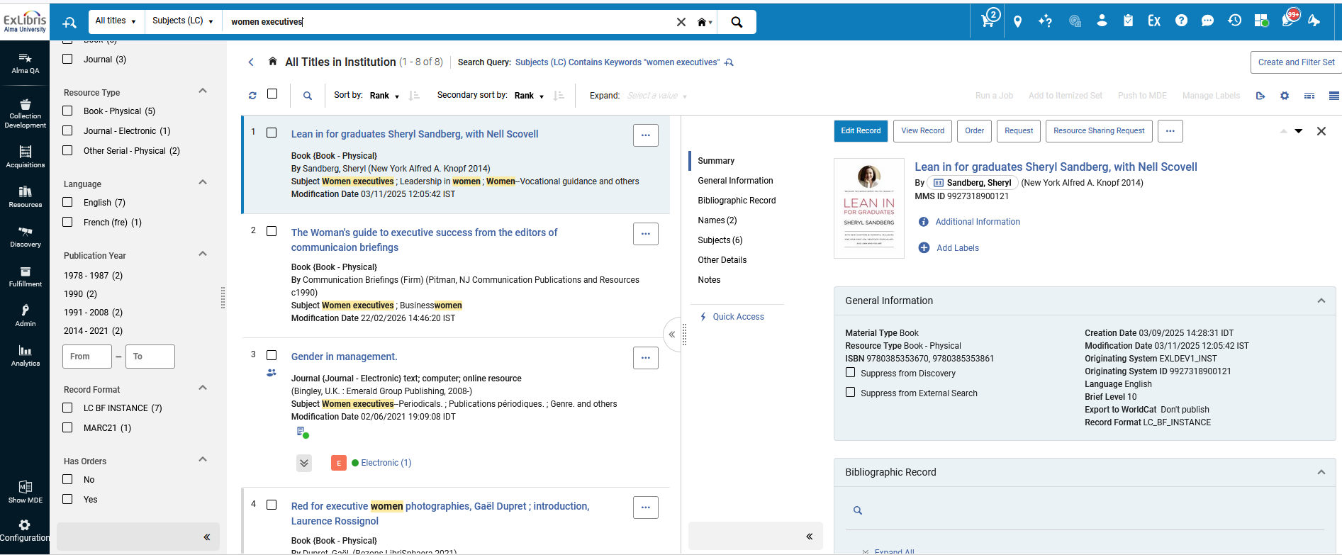
Searching for and retrieving the Instance
One option is to perform a search and then facet by Record Format LC BF INSTANCE

Slide 27
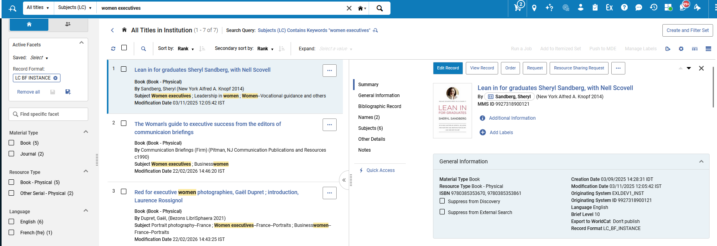
Searching for and retrieving the Instance
First, we searched All Titles for “Subjects (LC)” with words “women executives”.
Then, we faceted by Record Format = LC BF INSTANCE

Slide 28
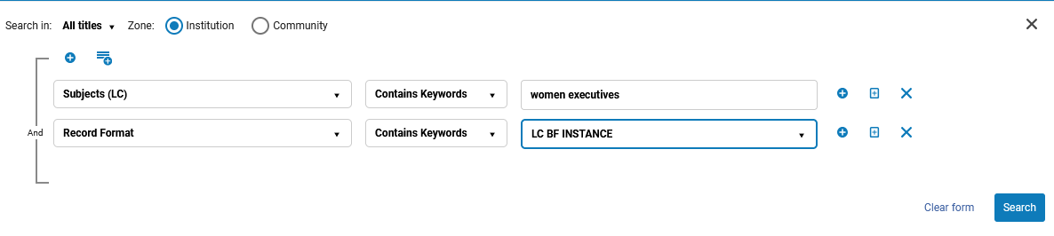
Searching for and retrieving the Instance
Using the advanced search, we could have limited our results to Record Format LC BF INSTANCE as part of the search (and then there would be no need to facet by Record Format)

Slide 29
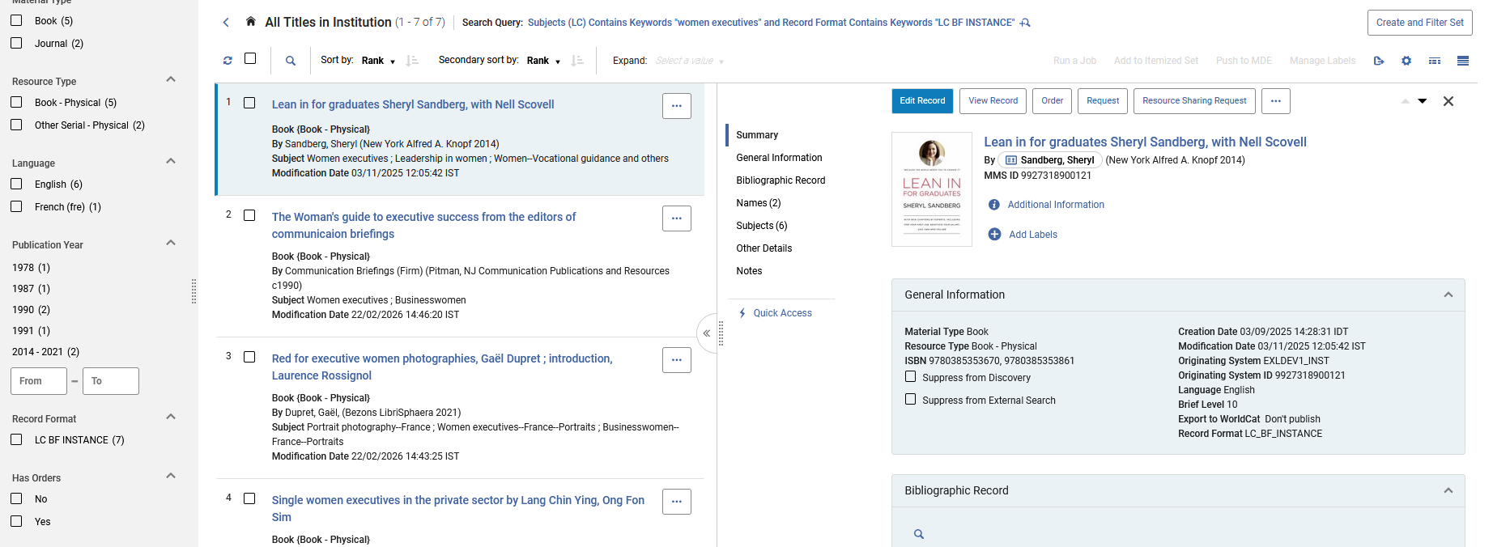
Searching for and retrieving the Instance
Now all results are LC BF INSTANCE

Slide 30
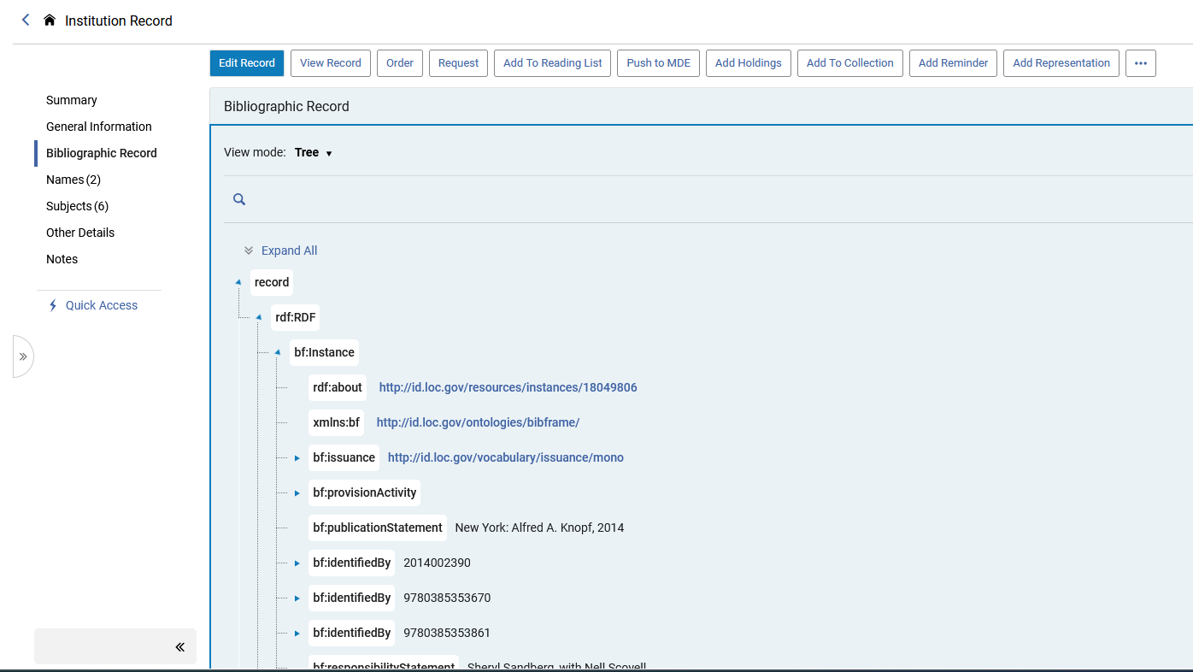
Searching for and retrieving the Instance
From the search results it is possible to view the Instance in tree format
This “Tree” format can also be viewed in a “RDF/XML” view as well as a “Table” view.
This is described in detail in section “The Tree, RDF/XML, and Table View modes” in this presentation.

Slide 31
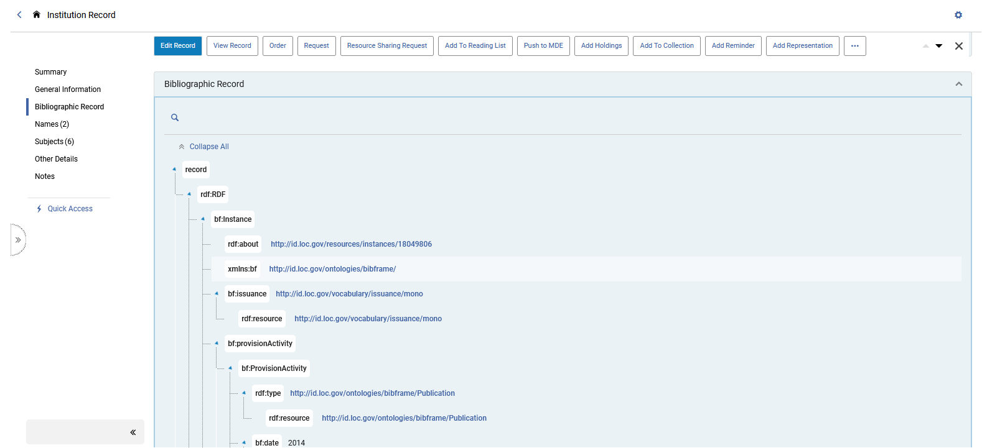
Searching for and retrieving the Instance
And from the “View record” option it is possible to view the record encoded in RDF/XML.
We will now click “View Record”

Slide 32
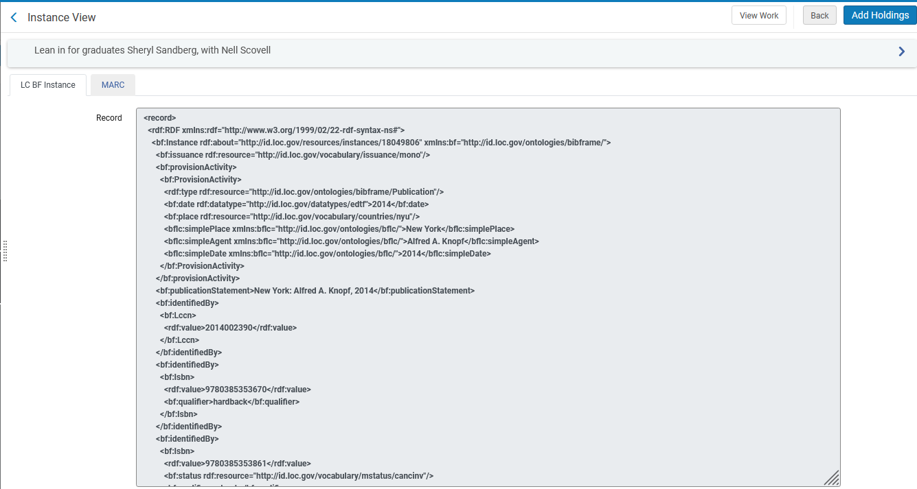
Searching for and retrieving the Instance
Here is the record encoded in RDF/XML.
We will now click “MARC” and see an “on the fly” conversion to MARC

Slide 33
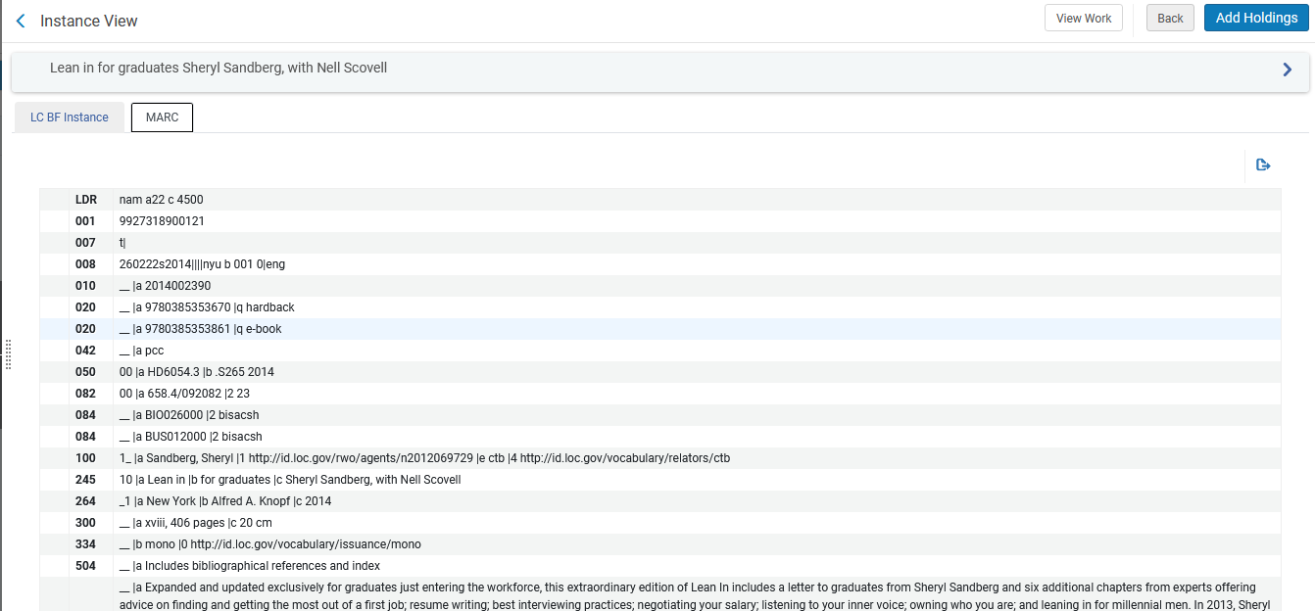
Searching for and retrieving the Instance
We now see a conversion to MARC of the Instance.

Slide 34
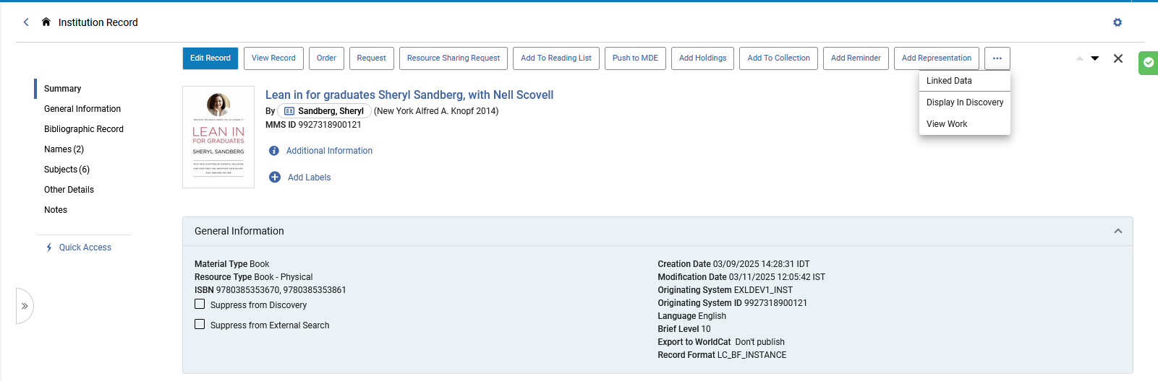
Searching for and retrieving the Instance
We can also easily navigate from the Instance to the Work. We will now click “View Work” for this Instance of “Lean in for graduates Sheryl Sandberg, with Nell Scovell”

Slide 35
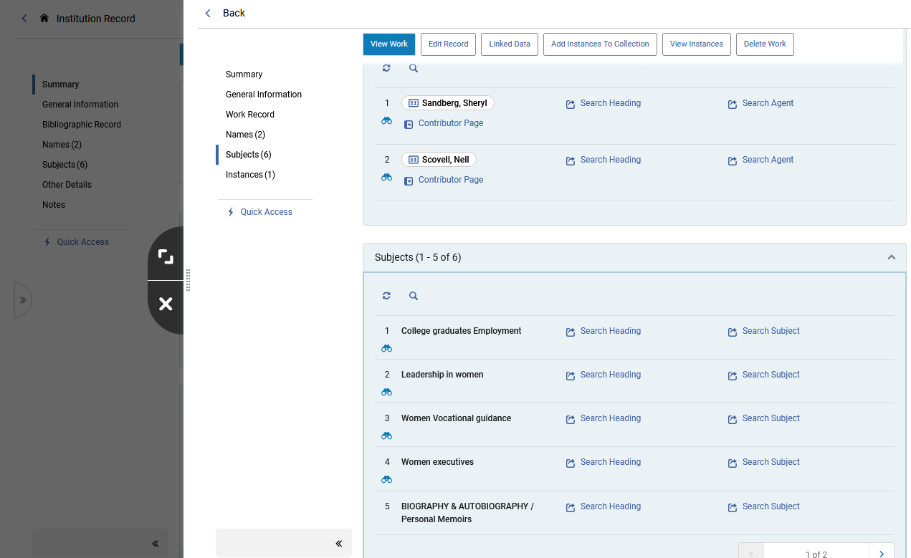
Searching for and retrieving the Instance
The Work will then open in a sliding panel

Slide 36
Viewing and editing the Work and Instance after retrieving

Slide 37
Viewing and editing the Work and Instance after retrieving
Clicking the “View Work” after retrieving a Work allows the staff user to
  View the BIBFRAME record in RDF/XML format
  View an “on the fly” conversion of the record to MARC
The Work

Slide 38
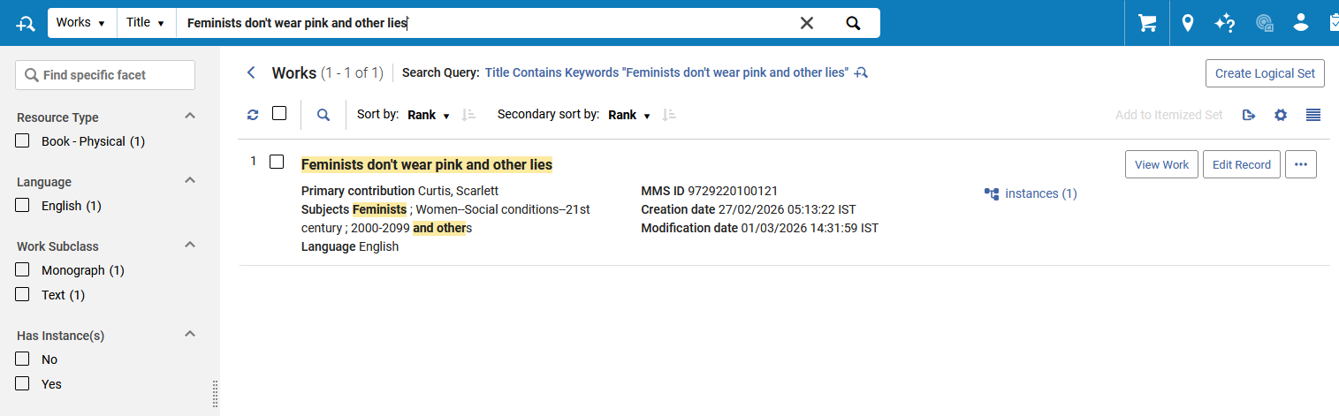
Viewing and editing the Work and Instance after retrieving
We have retrieved Work title “Feminists don't wear pink and other lies” and will view the Work
The Work

Slide 39
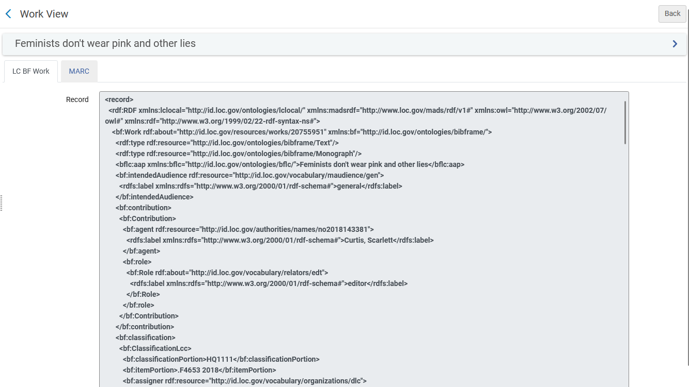
Viewing and editing the Work and Instance after retrieving
Here is the BIBFRAME Work in RDF/XML format
The Work

Slide 40
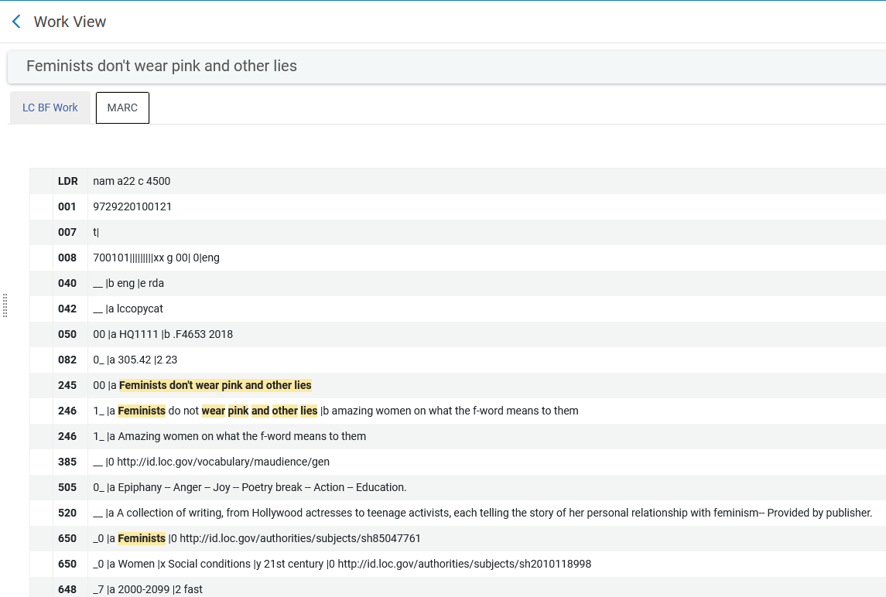
Viewing and editing the Work and Instance after retrieving
Here is the BIBFRAME Work converted on the fly to MARC
The Work

Slide 41
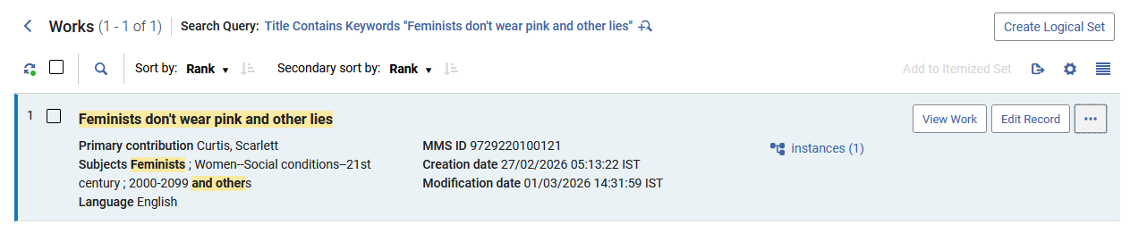
Viewing and editing the Work and Instance after retrieving
Now the staff user will click “Edit Record” for the BIBFRAME Work
The Work

Slide 42
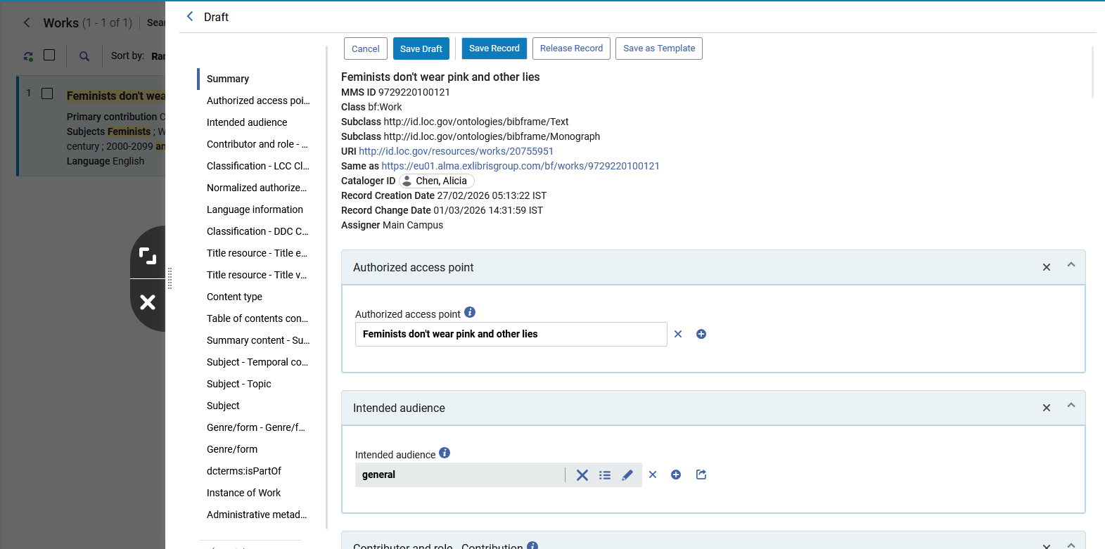
Viewing and editing the Work and Instance after retrieving
The BIBFRAME Work opens in editing mode. This will be discussed more in depth in the presentation on the Linked Open Data for BIBFRAME editor.
What is important now is that the staff user can navigate through the record by clicking each section in the navigation bar rather than scrolling through the record.
The Work
Staff user can navigate through the record by clicking each section

Slide 43
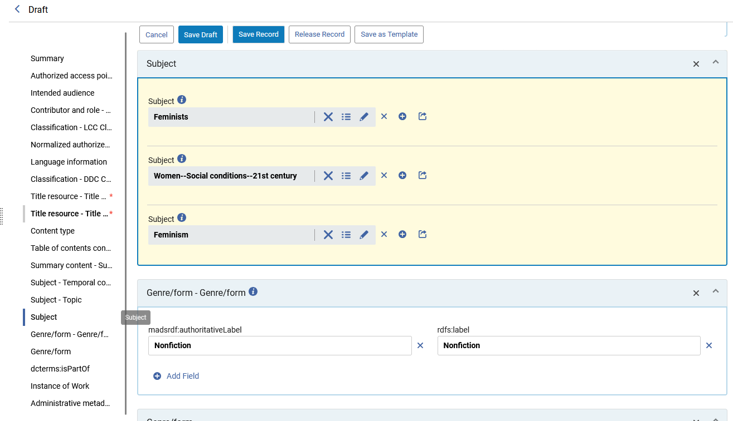
Viewing and editing the Work and Instance after retrieving
The Work
Here the staff user clicked “Subject” and arrived directly to that section.

Slide 44
Viewing and editing the Work and Instance after retrieving
Clicking the “View Record” after retrieving an Instance allows the staff user to
  View the BIBFRAME record in RDF/XML format
  View an “on the fly” conversion of the record to MARC
The Instance

Slide 45
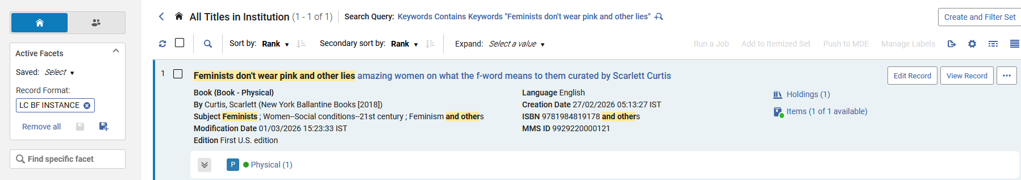
Viewing and editing the Work and Instance after retrieving
We have retrieved Instance title “Feminists don't wear pink and other lies” and will click “View Record”
The Instance

Slide 46
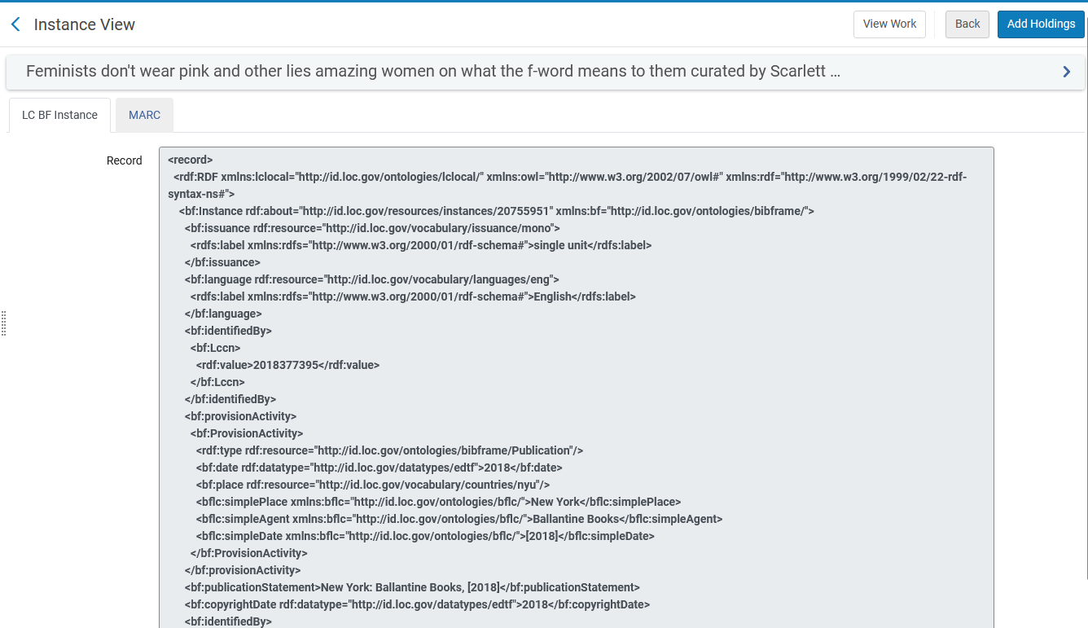
Viewing and editing the Work and Instance after retrieving
Here is the BIBFRAME Instance in RDF/XML format
The Instance

Slide 47
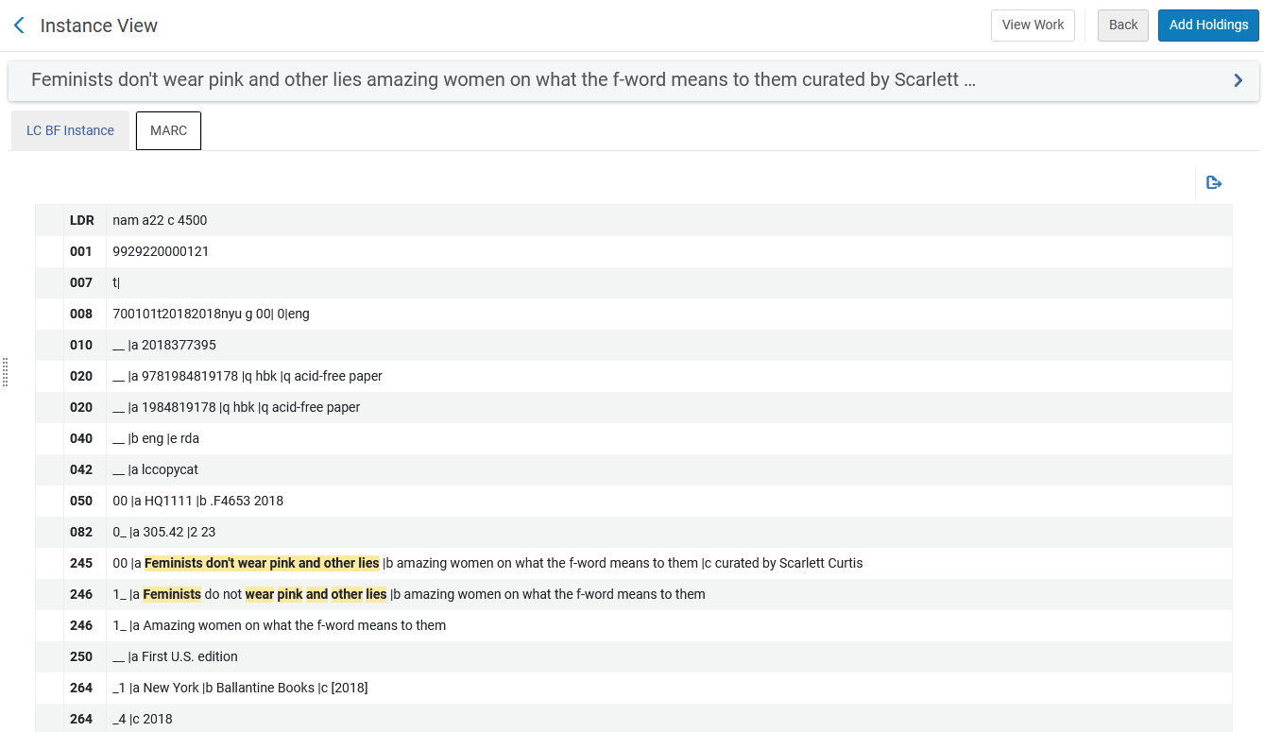
Viewing and editing the Work and Instance after retrieving
Here is the BIBFRAME Instance converted on the fly to MARC
The Instance

Slide 48
Viewing and editing the Work and Instance after retrieving
Now the staff user will click “Edit Record” for the BIBFRAME Instance
The Instance

Slide 49
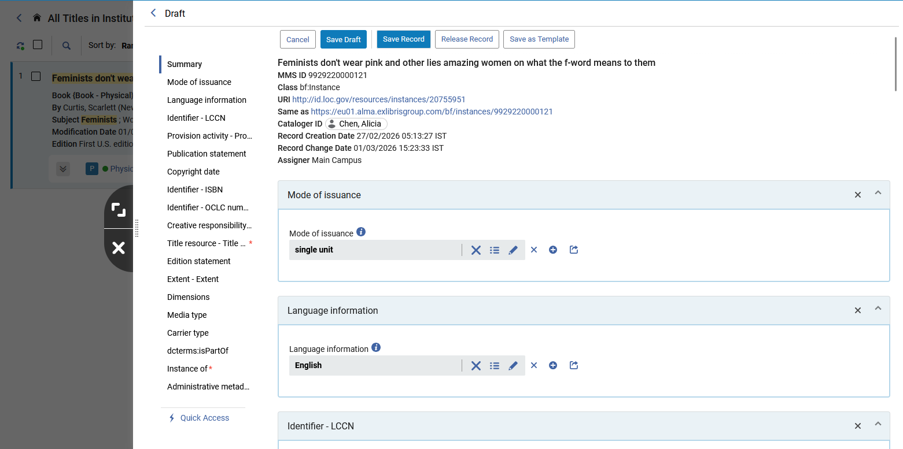
Viewing and editing the Work and Instance after retrieving
The BIBFRAME Instance opens in editing mode. This will be discussed more in depth in the presentation on the Linked Open Data for BIBFRAME editor.
What is important now is that the staff user can navigate through the record by clicking each section in the navigation bar rather than scrolling through the record.
The Instance
Staff user can navigate through the record by clicking each section

Slide 50
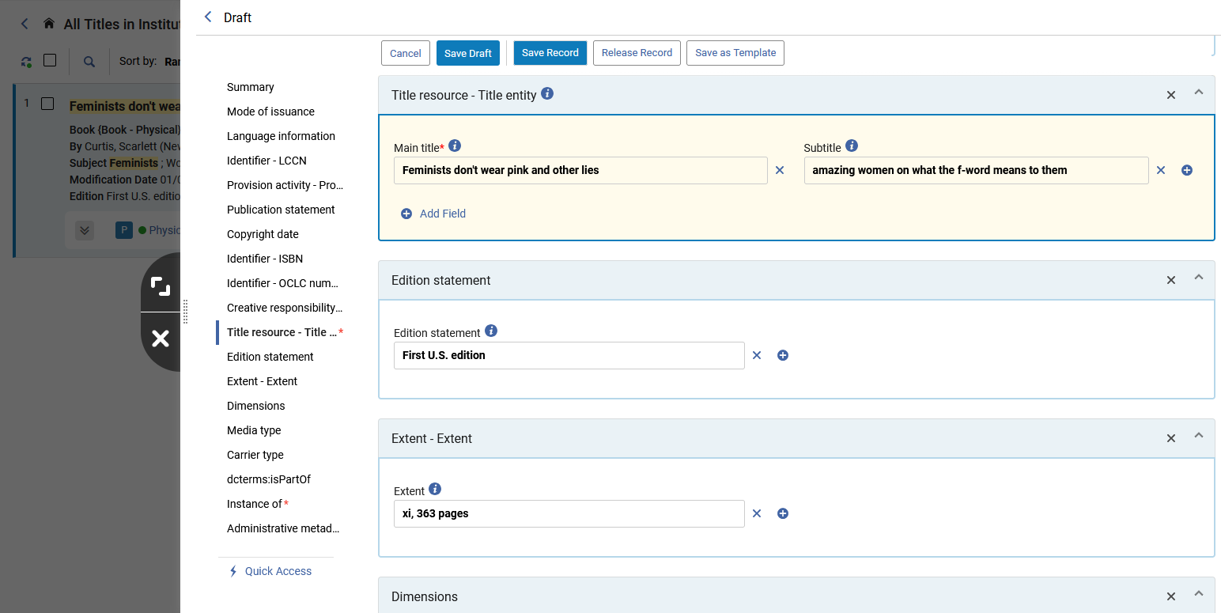
Viewing and editing the Work and Instance after retrieving
The Instance
Here the staff user clicked “Title resource - Title entity” and arrived directly to that section.

Slide 51
The Tree, RDF/XML, and Table View modes

Slide 52
The Tree, RDF/XML, and Table View modes
From the repository search results it is possible to view both the Work and Instance in the following formats:
  Tree
  RDF/XML
  Table
This is useful in getting a one-glance overview of the record.

Slide 53
The Tree, RDF/XML, and Table View modes
This is done by
  Searching for the record
  Clicking the title (to view the record)
  Moving to the section:
    “Work Record” (for a Work)
    “Bibliographic Record” (for an Instance)
  Toggling between the three formats
We will now see this live, first looking at the Work and then at the Instance.

Slide 54
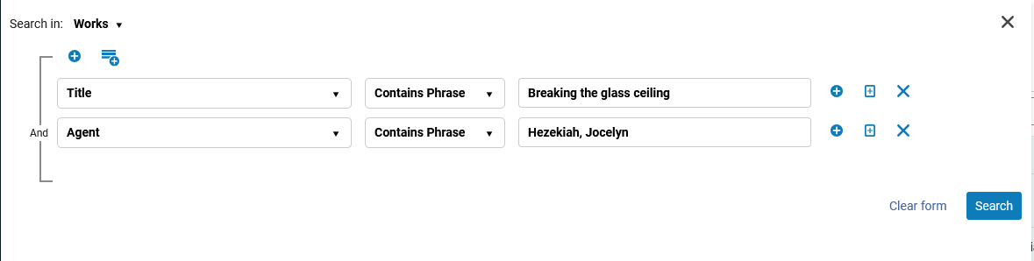
The Tree, RDF/XML, and Table View modes
Here we are searching for BIBFRAME Work title “Breaking the glass ceiling” by agent “Hezekiah, Jocelyn”

Slide 55
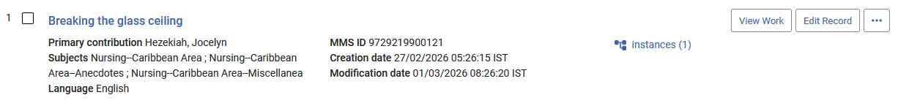
The Tree, RDF/XML, and Table View modes
Now we will click the title to view the Work

Slide 56
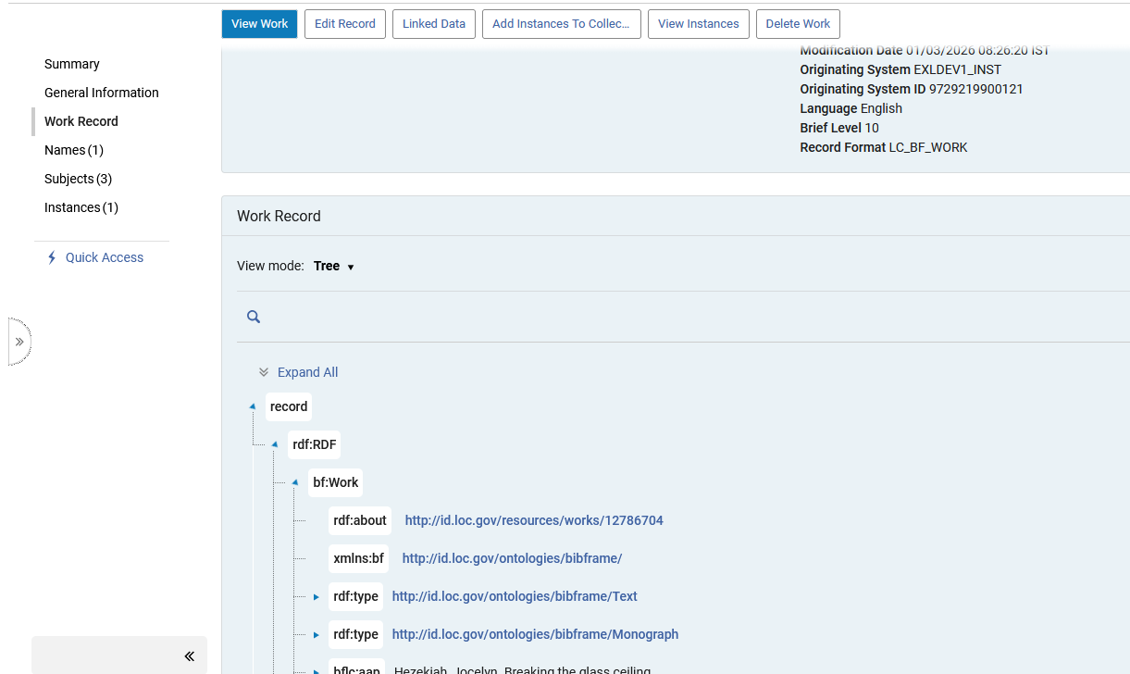
The Tree, RDF/XML, and Table View modes
In the section “Work Record” the Work appears by default in “Tree” view

Slide 57
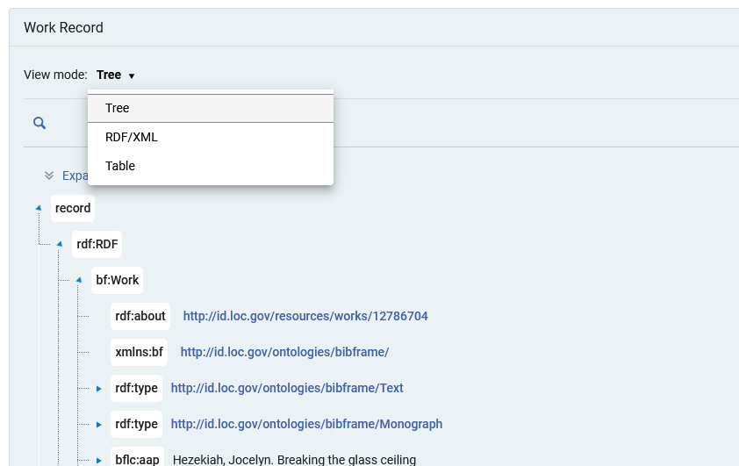
The Tree, RDF/XML, and Table View modes
The staff user can change the view of the Work to RDF/XML or Table
Note that the selection of the View mode is “sticky”. Thus, if the staff user changes the display in one record, then the next opened record will automatically have the same previously-chosen View mode.

Slide 58
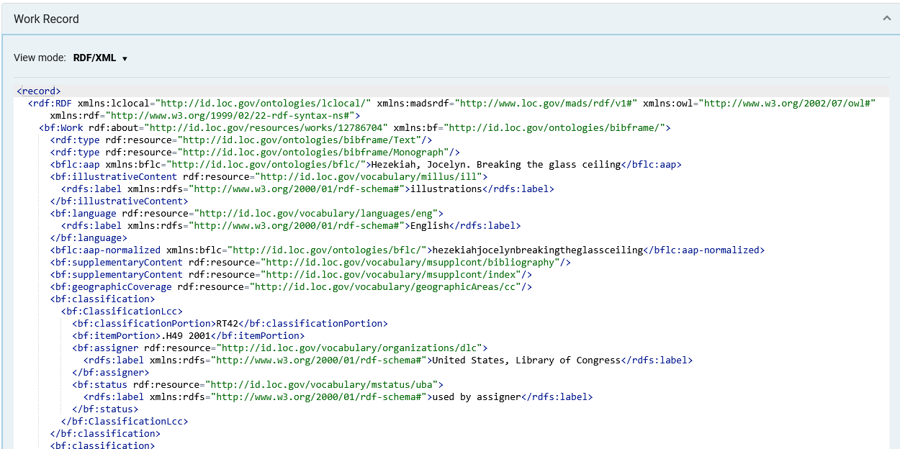
The Tree, RDF/XML, and Table View modes
Here is the Work in RDF/XML view

Slide 59
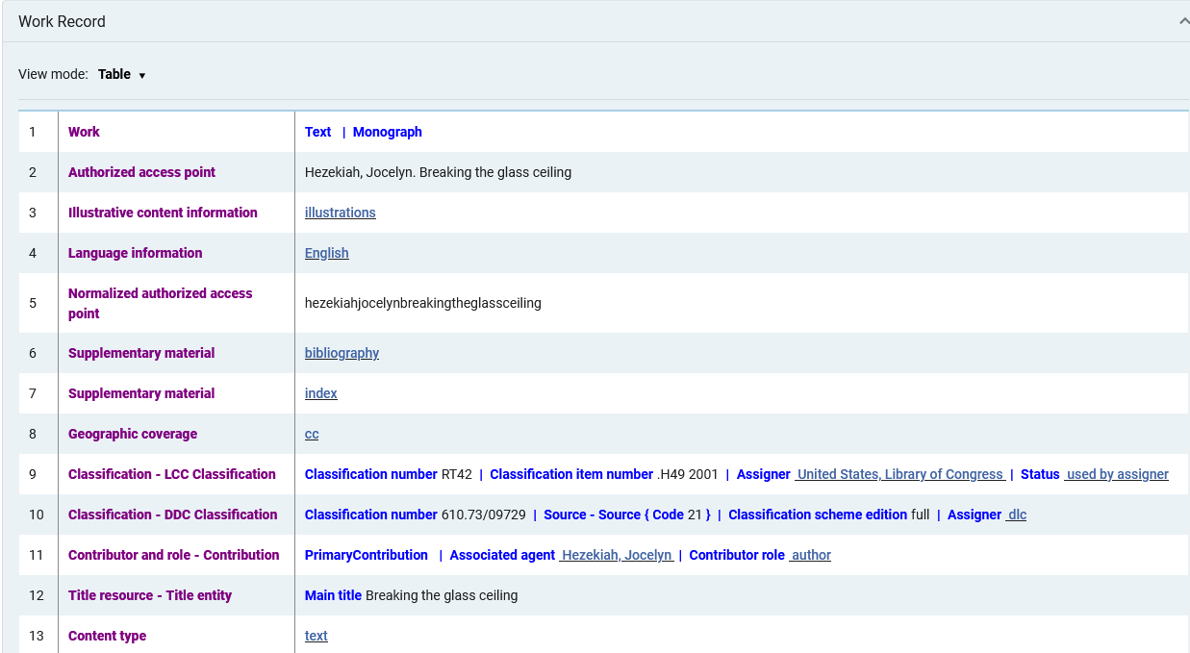
The Tree, RDF/XML, and Table View modes
Here is the Work in Table view

Slide 60
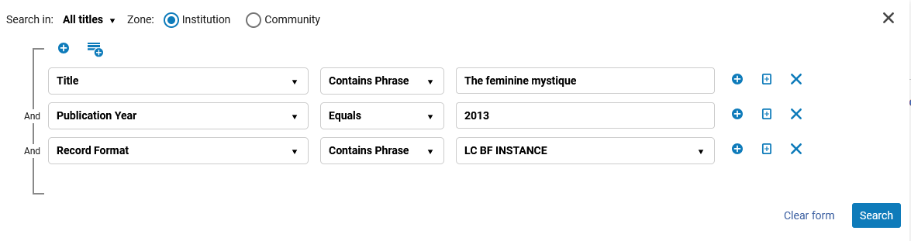
The Tree, RDF/XML, and Table View modes
Here we are searching for BIBFRAME Instance title “The feminine mystique” published in 2013

Slide 61
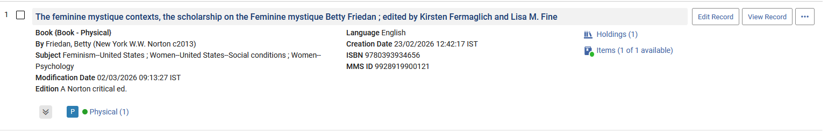
The Tree, RDF/XML, and Table View modes
Now we will click the title to view the Instance

Slide 62
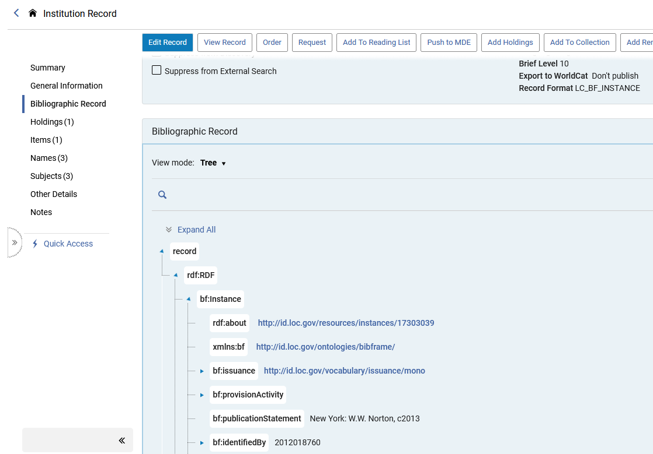
The Tree, RDF/XML, and Table View modes
In the section “Bibliographic Record” the Instance appears by default in “Tree” view

Slide 63
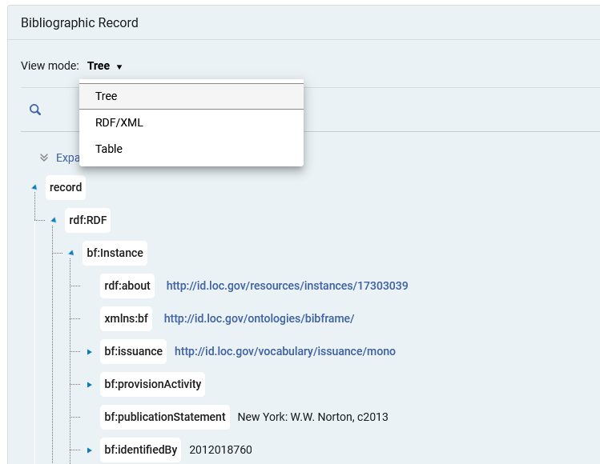
The Tree, RDF/XML, and Table View modes
The staff user can change the view of the Instance to RDF/XML or Table

Slide 64
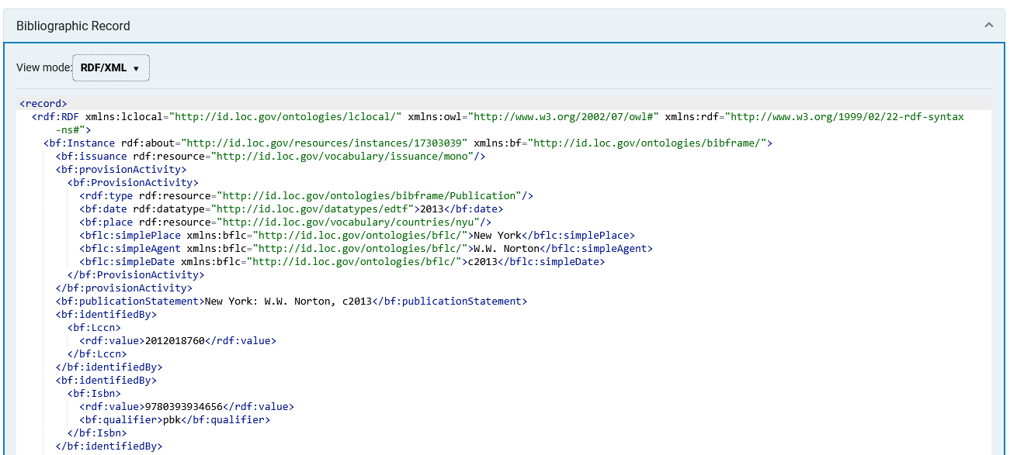
The Tree, RDF/XML, and Table View modes
Here is the Instance in RDF/XML view

Slide 65
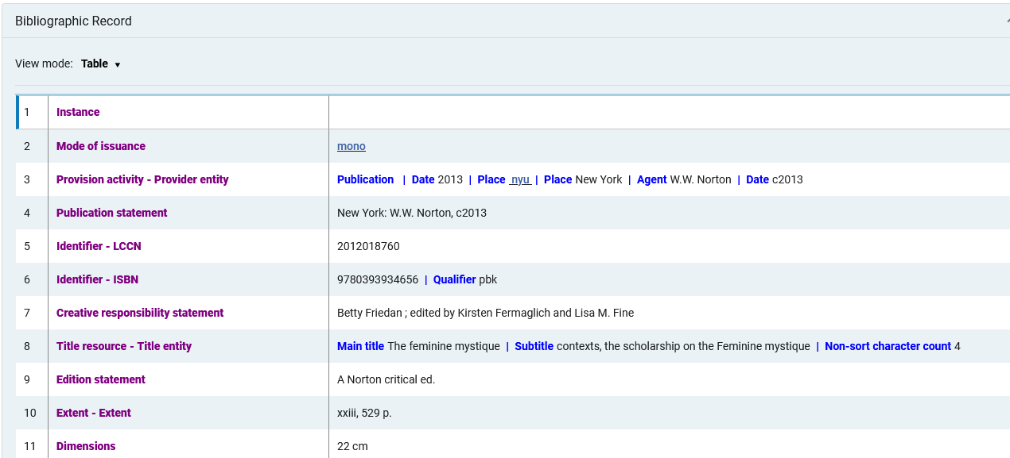
The Tree, RDF/XML, and Table View modes
Here is the Instance in Table view

Slide 66


Yoel Kortick
Yoel.Kortick@clarivate.com
About Clarivate
Clarivate is a leading global provider of transformative intelligence. We offer enriched data,
insights & analytics, workflow solutions and expert services in the areas of Academia & Government, Intellectual Property and Life Sciences & Healthcare. For more information, please visit clarivate.com.
© 2026 Clarivate. All rights reserved
Clarivate and its logo, as well as all other trademarks used herein are trademarks of their respective owners and used under license.

